Slide 1
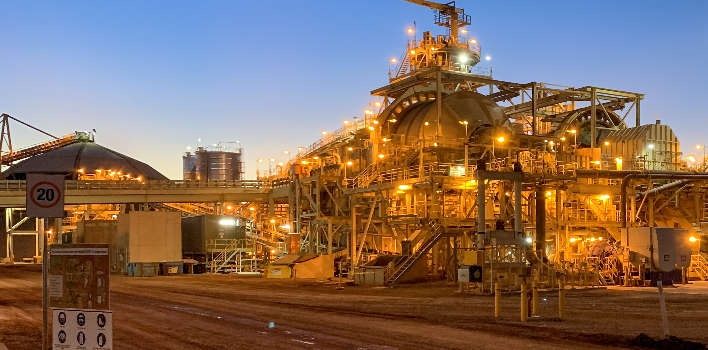
BEC Engineering
Company Overview
“A leading provider of specialist electrical design services to the resources sector”
Image from: Grinding Mill, Gruyere Gold Mine, Newbury WA, Gruyere JV

Slide 2
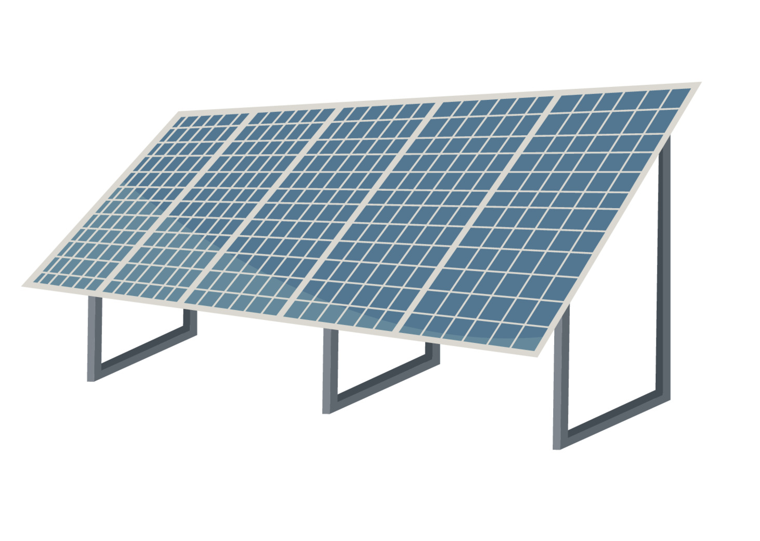

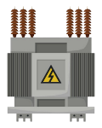
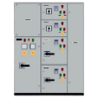

1. Company Overview
Company Summary
BEC is an Electrical Design Engineering One Stop Shop
BEC is a Perth based engineering consultancy founded in 1996, with an impressive reputation and client base due to its long history of successful project and service delivery.
BEC provides specialist professional electrical engineering services to the mining and materials handling sectors. BEC has a team of skilled electrical, power and control system engineers, who deliver services for projects in Australia and around the world.
BEC offers a full suite of electrical design capabilities:
BEC services all aspects of the asset life cycle:
1
Power Systems & Generation
Feasibility
Map illustrating BEC’s global and WA project experience
2
Transmission
Design
Global Project Location
Recent Australian Projects
Installation Supervision
&
Commissioning
3
Distribution
4
Electrical and Instrumentation
Service & Maintenance
5
Controls and Automation
Decommissioning

Slide 3
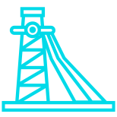

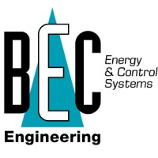




2. Capabilities Overview
BEC delivers innovative engineering solutions across the complete range of electrical, power, automation and control systems for client projects.
Electrical & Instrumentation
Core Capabilities
Automation & Controls
As a preferred engineering solutions provider to the mining industry, BEC has the capability to deliver electrical engineering solutions from design through to implementation, ranging from small infrastructure upgrades to highly complex generation and distribution projects, together with ongoing technical support.
Electrical & Instrumentation
BEC harnesses sophisticated technology to deliver customised, automated systems with noticeable cost benefits. BEC is an industry-recognised system integrator and supplier for all major manufacturers of control and automation systems, including Allen Bradley, GE, Rockwell Automation, Schneider and Emerson.
Automation & Controls
Power Generation
Technology & Innovation
Design & Drafting
Project Services & Support
Power Systems & Generation
Technology & Innovation
All projects depend on a safe and reliable power system. BEC’s power systems group provides comprehensive engineering solutions for project networks, including grid connection requirements for new plants and network design for utility infrastructure upgrades.
BEC develops custom, innovative technology-driven solutions using the latest sensor technology (lidar & radar), networking and automation technology to address complex problems, to eliminate operational delays, increase throughput and improve safety.
Project Services & Support
Design & Drafting
BEC offers continual, seamlessly integrated project delivery services through every stage of the project and its operational life.
BEC’s project delivery services include design and drafting, feasibility studies, EPC/EPCM contracts, and construction supervision, commissioning and training.
The design drafting team works side by side with the BEC engineers to ensure a complete, compliant and fully documented electrical design package.
The team has expertise in electrical design, 3D modelling and site as-built using design software including AutoCAD, MicroStation and Navisworks.

Slide 4

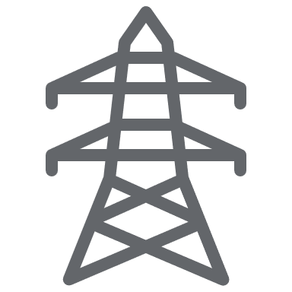








3. Power Systems
BEC provides design, management and turnkey solutions for power systems and generation in remote locations.
Overview
Capabilities
BEC has a dedicated Power Systems team offering comprehensive engineering solutions for power networks. As all projects are built upon safe and reliable power systems, having this capability means BEC is engaged in the early phases of any projects.
BEC offers design, management and turnkey solutions for existing plant or new projects and undertakes all grid connection requirements, including network planning for utility infrastructure upgrades and the integration of renewables. The team stays abreast of technological change, reflected in BEC’s system designs which routinely set industry standards.
With a successful track record of delivering complex power projects for remote locations both in Australia and around the world, BEC provides clients with a cost-effective solution, whether the aim is to increase power capacity, maximise efficiency or design a new power station.
Capital and operational costing studies and feasibilities
Electrical power system design for transmission and distribution
Design: utility connection protection systems
Design for the integration of renewables
Network stability and generation optimisation
Utility and supply authority negotiations
Insurance and accident investigation
Equipment management: investigation and design of automation systems
Protection schemes
Substation design and construction
Earthing system audit and design
Electrical safety audits
Energy management
Harmonic distortion analysis
Power factor correction
Power system studies and fault analysis
Any Project
Small LV Studies
HV substation and power line design
Major Clients

Slide 5
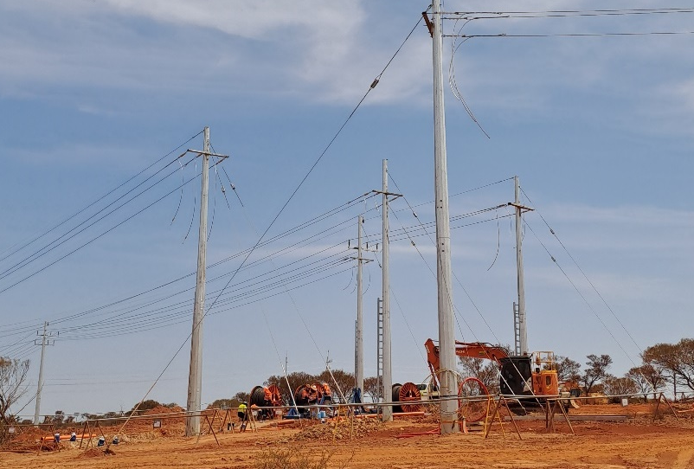
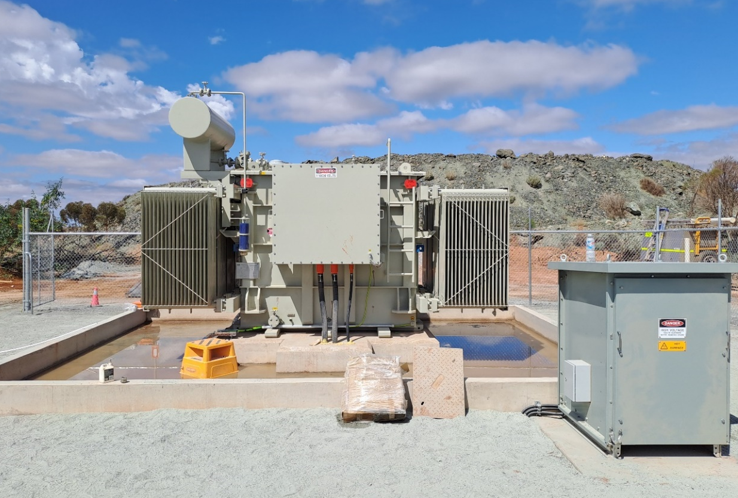
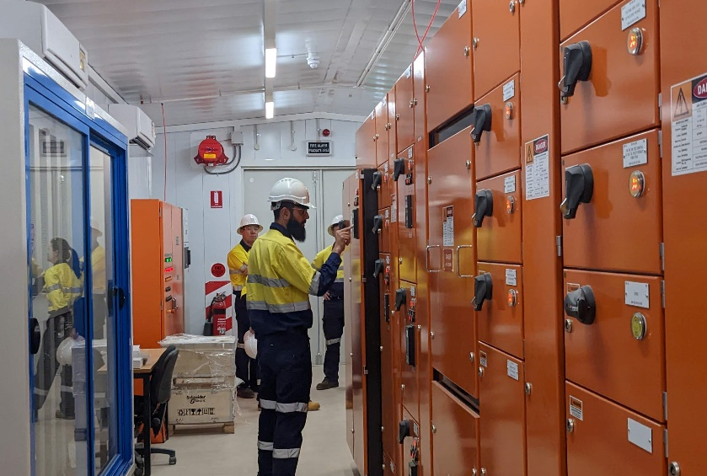
3. Power Systems
Some recent and ongoing projects being completed by the BEC Power Systems team.
Jubilee 33/11 kV Substation (2023)
Bellevue Gold 33kV and 11kV Power Line (2023 – Present)
HV Infrastructure Upgrade (2023)
Location: South Kalgoorlie, Western Australia
Client: Northern Star Resources
Fee: $0.13 million
Location: Leinster, Western Australia
Client: Bellevue Gold
Fee: $ 0.16 million
Location: Agnew Gold Mine, Leinster, Western Australia
Client: Goldfields Australia
Fee: $ 0.21 million
BEC Engineering has been engaged to design and commission the 33/11 kV substation and a 1.4 km, 33 kV overhead spur line connecting to the existing overhead line. This will provide a utility connection for the underground mining operations and include an interlocked changeover facility with the diesel power station.
BEC has completed the design, installation, and commissioning process. The project is now fully connected and operational.
BEC Engineering was engaged by the powerline contractor, Allied Power, to complete the design of the main 11kV and 33kV overhead power lines and reticulation from the hybrid power station to the mine and associated process operations.
The design was completed, and the first stage was commissioned in late 2023 with further commissioning to be completed in 2024.
Following the initial scoping study completed by BEC, BEC was engaged by Goldfields to complete the design for the HV infrastructure upgrades required to support the mine expansion. Works included all HV studies, design, and regulatory submission for the expansion of the overhead power line and the new surface and underground substations.
The project is currently on ongoing.

Slide 6
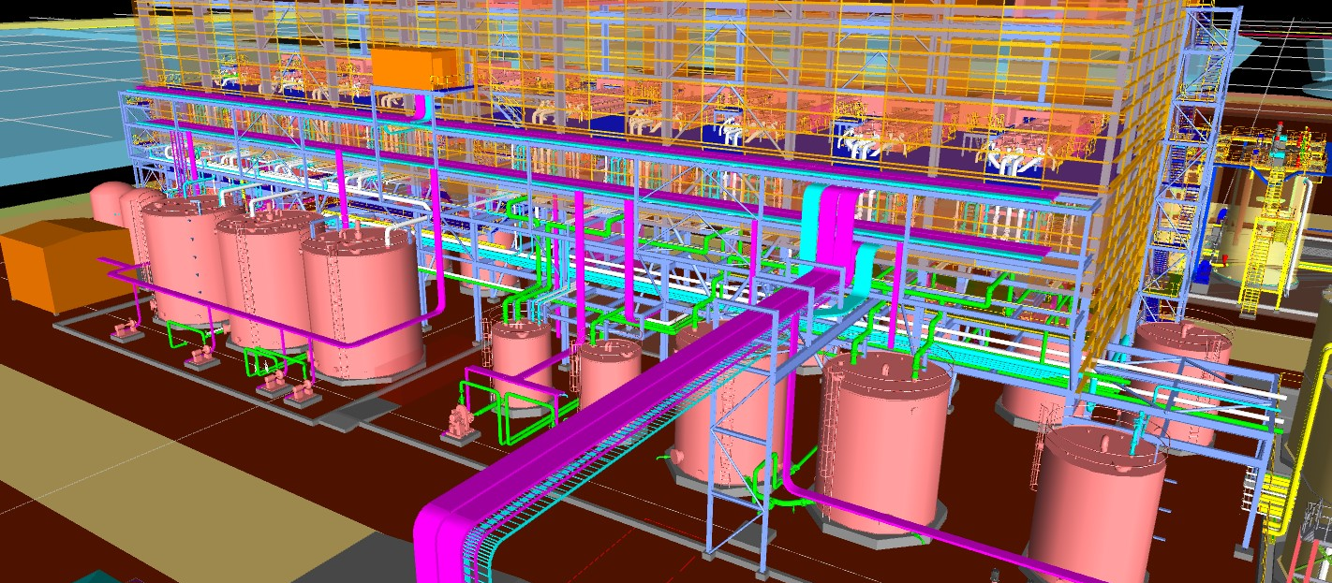



4. Electrical & Instrumentation
BEC provides integrated electrical and instrumentation project solutions from design through to commissioning and subsequent support.
Overview
Capabilities
BEC’s E&I team includes engineers, technicians, programmers, draftspersons and site support staff, bringing the combined experience and expertise to undertake and complete projects from feasibility through to implementation, with a commitment to ongoing technical support.
BEC delivers a wide range of E&I solutions, irrespective of project location and size, ranging from small infrastructure upgrades or highly complex electrical generation and distribution requirements for major development.
E&I projects are diverse and design timeframes vary from weeks to months depending on the size and nature of the project. BEC undertakes both EPCM and EPC projects.
The E&I team plays an active role through site commissioning with BEC engineers being closely involved in installation supervision and commissioning to ensure transfer of information during the critical phase of the project.
Electrical HV/LV system design and master planning
Electrical and instrumentation equipment selection
Switchboard and Motor Control Centres design and specification
Co-generation and energy management
Power factor correction
Reticulation and busbar systems
Stand-by power generation
Substation planning: supply, authority, negotiations, and coordination
Surge protection
Major Clients
3D Processing Plant Design, Kalgoorlie, WA,
Lynas Rare Earths
Notes:
Shpiel for photo

Slide 7
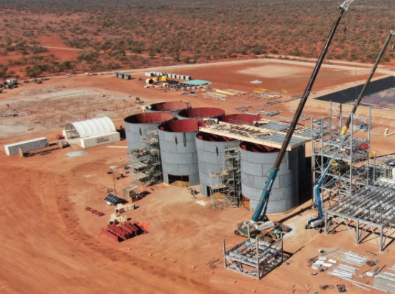
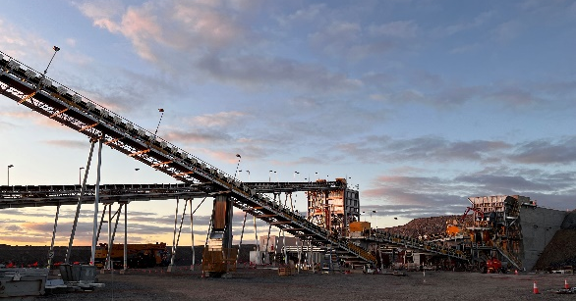
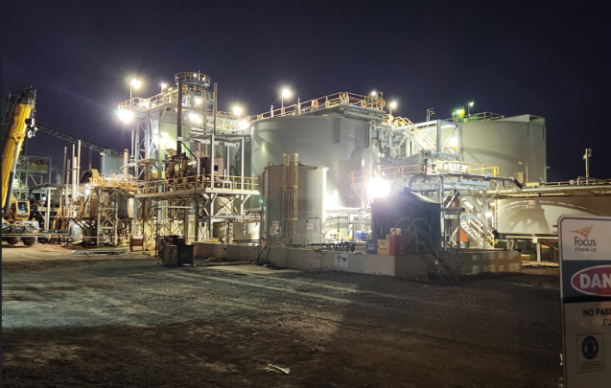
4. Electrical & Instrumentation
Some recent and ongoing projects being completed by the BEC E&I team.
King of the Hills Gold Mine (2022)
Agnew Crushing Upgrade (2022)
Three Mile Hill Gold Plant Refurbishment (2023)
Location: Goldfields, Western Australia
Client: MACA Interquip
Fee: $0.87 million
Location: Leinster, Western Australia
Client: Gold Fields Australia
Fee: $0.60 million
Location: Coolgardie, Western Australia
Client: Maca Interquip
Fee: $0.65 million
BEC was engaged by Maca Interquip to perform the electrical design and control system works for the RED 5 King of the Hills Gold Mine located in the Eastern Goldfields of Western Australia.
Design included HV and LV distribution, instrumentation, lighting and small power.
The design commenced in late 2020 and was completed in November 2021. BEC provided the construction supervision and commissioning resources over a seven month period in the first half of 2022.
The crushing circuit at Gold Fields’ Agnew operations was required to be upgraded to increase the throughput of the plant and suit the ore being treated. A three-stage crushing circuit was opted for and Gold Fields engaged BEC to perform the entire electrical design from the HV supply to the LV distribution and controls.
The project was commissioned in the second half of 2022 with BEC also supplying the site supervision during construction and commissioning.
The successful completion of the project allowed the Agnew Operations to shut-down and decommission the original crushing circuit.
The Three Mile Hill gold mine is a historic mine just out of Coolgardie. The plant had been on care and maintenance for approximately ten years.
BEC was tasked with the complete design and commissioning of replacement switch rooms and Motor Control Centers. The works included determining which electrical equipment could still be used, which needed replacing, and in some cases, detailing refurbishment tasks.
The project was delivered on time and under budget with the new plant having poured its first gold in August 2023.

Slide 8








5. Automation & Control Systems
BEC has an outstanding track record and reputation as automation and process control systems specialists.
Overview
Capabilities
Automation & Control Systems
The BEC Automation team encompasses all aspects of automation for existing and new plant. BEC adopts the latest technology to deliver customised automated systems for mobile or fixed equipment regardless of the proprietary system, regularly achieving highly visible cost benefits for its clients.
The BEC Control Systems team is well known in the industry as process control systems specialists and has an enviable track record across diverse practices and distinctive and complex plants.
The BEC Control Systems team leverages its deep industry knowledge to quickly evaluate client processes, assess the variables and design innovative and reliable solutions to optimise the response of plants to changing conditions. Site commissioning, plant tuning and training is performed by the Control Systems team, ensuring a smooth transition to client operations.
The BEC Control Systems team are certified Systems Integrators for many of the leading global control platform suppliers. Additionally, BEC works with boutique solutions where this is the client's preference. This diverse skillset and approach ensures BEC can service a wide subset of clients.
Automation
Automation feasibility studies
Embedded PC controllers
Field installation audits
GPS, inclinometer and gyroscope instrumentation
Instrumentation
Operator interface terminals
Plant optimisation
Process control system optimisation
Remote control systems
Remote site support
Retrofitting PLC and SCADA systems
RFID tagging systems
Telemetry systems
Vision and camera systems
Control Systems
Complete, turnkey advanced process control systems
Communication systems and network infrastructure
Multi-variable grinding mill controls and equipment
Plant control system audits
PLC, DCS and SCADA technology including complete software systems
Process and plant optimisation
Telemetry systems
Supplier of:
Major Clients

Slide 9
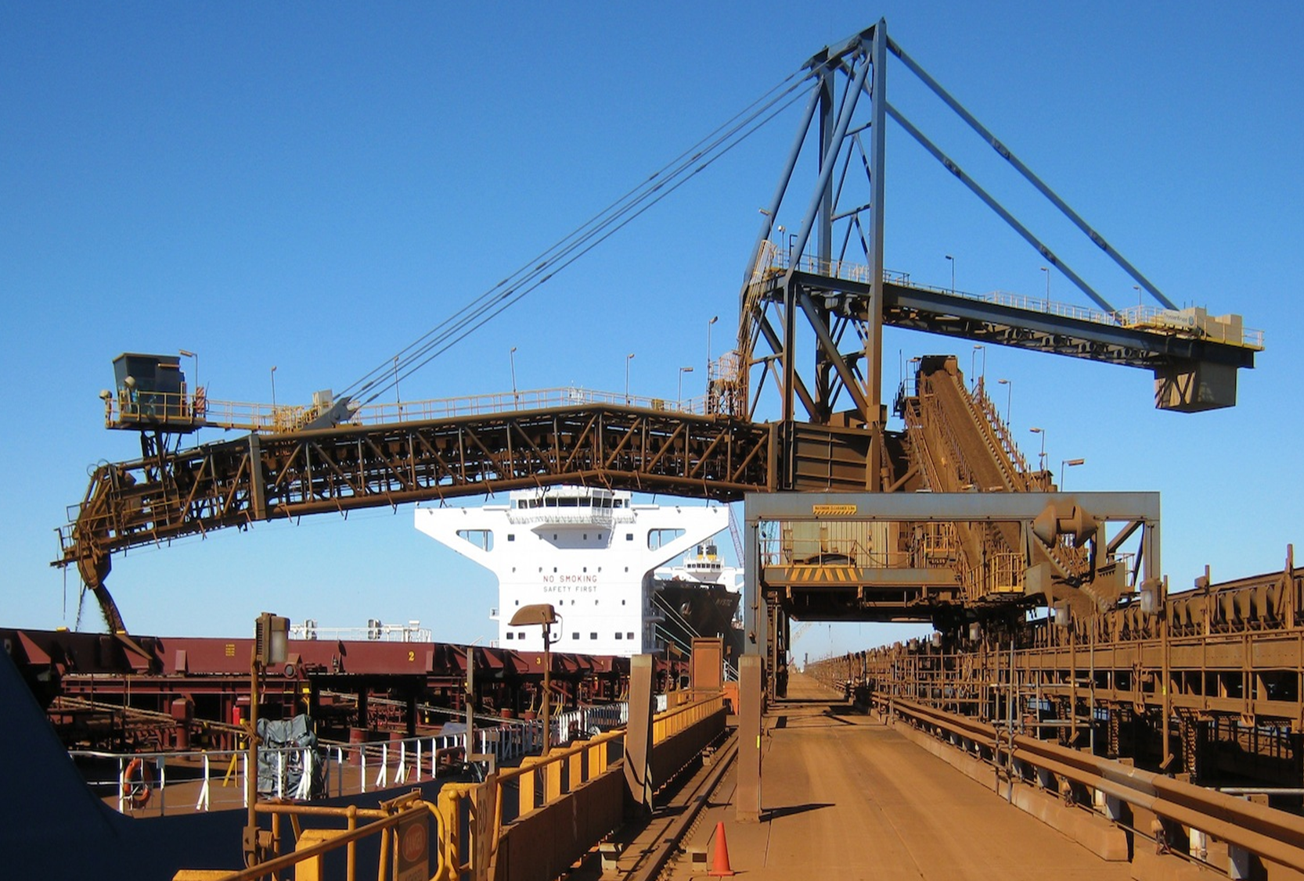
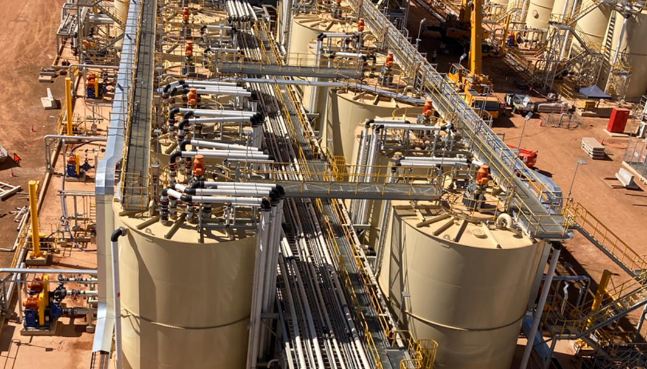
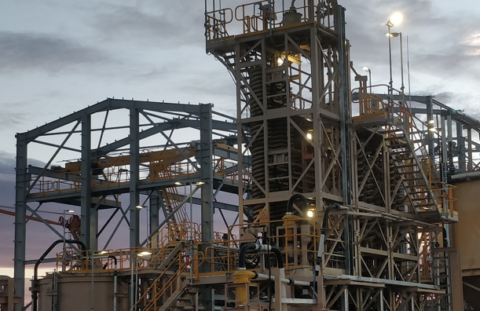
5. Automation & Control Systems
Some recent and ongoing projects being completed by the BEC Automation and Control Systems team.
Fortescue Canyon G (2021-2023)
Lynas Cracking and Leaching Plant (2020 – Present)
Iluka Eneabba Project Phase 2 (2020 – 2022)
Location: Port Hedland, Western Australia
Client: Fortescue
Fee: $1.18 million
Location: Kalgoorlie, Western Australia
Client: Lynas Rare Earths
Fee: $0.83 million
Location: Eneabba, Western Australia
Client: Iluka Resources
Fee: $0.64 million
BEC was engaged by Fortescue to perform the complete control system design and commissioning of the Canyon G stockyard expansion.
The purpose of the expansion was to accommodate magnetite ore from the Fortescue Iron Bridge mine. Works included a new stacker, conveyors, sample station, and integration with the port ore management systems.
Design commenced late 2021, with commissioning performed early 2023. BEC was an integral part of the first magnetite ore shipment in July 2023.
BEC is currently engaged by Lynas Kalgoorlie to perform the complete control system design and commissioning for the new Cracking and Leaching Plant currently under construction in Kalgoorlie.
The controls group combined with the E&I group to design and develop an integrated control system for approximately 350 drives, 1500 instruments, and multiple vendor packages.
On-site commissioning and plant tuning is in progress for client handover.
Following the successful completion of the Eneabba Mineral Sands Recovery Project, BEC was engaged by Iluka Resources to perform the control system design and commissioning for the Phase 2 Project (Beneficiation Plant).
The controls group combined with the E&I group to design and develop an integrated control system.
Design commenced late 2020, with commissioning completed in 2022.

Slide 10
6. Technology, Innovation & Bespoke Solutions
BEC is expert in understanding, defining and implementing technology-driven solutions and products for complex problems in the mining industry.
Overview
1. BEC Engaged to Identify Problem
2. BEC Designs Solution
BEC is engaged by clients who are facing technical challenges for which there is no off-the-shelf, or other existing solution. BEC will initially work with the client to identify the problem and the full scope of the engagement.
BEC designs a solution to the problem at hand using its in house capabilities and its experience with the following technologies:
App and solution development (e.g. C#/.NET, C++)
Database/ big data programming
IOT and lower power apps
Network and communication systems
OS and network protocols
Sensor technologies
Data, satellite, mobile, fibre, RF and microwave communications solutions.
01
02
IP Generation
Process
04
03
4. Roll Out
3. Solution Delivered to Client
BEC can then roll out the solution to other client site and installations. Additionally, BEC will provide on going service and maintenance.
BEC will then install, test and commission the solution for the client. The solutions are often designed to increase efficiencies or improve safety.

Slide 11






6. Technology, Innovation & Bespoke Solutions
BEC has developed, deployed a number of technology solutions. These solutions have been and are continuing to be deployed with clients such as Fortescue, BHP, Rio Tinto.
Case Studies
The LPDOC is the system of choice for measuring and reporting the volume of residual ore in rail wagons following the car dumper cycle. Ore wagons that are not fully unloaded pose an operational risk to safe, efficient rail operations due to the imbalance of ore remaining in the wagon. Developed and supported by BEC, the system has been deployed across multiple port ore handling facilities for the world’s premier iron ore miners (BHP, Rio Tinto & Fortescue).
Laser Ore Car Profiling System
The LGAP system provides a reliable solution to the problem of automatically locating the gap between the two ore cars to position the train indexer for correct arm insertion. The LGAP system monitors, detects and measures precisely the position of the ore car gap left, right and center, and provides these points to the indexer control system for real-time positioning of the arm.
Laser Gap Detection System
Bulk Measurement System
The CBMS is a complete turnkey solution to the problem of detecting, reporting and logging of ore volume, available capacity and belt drift on conveyor systems. The system provides key metrics on bulk conveyors that when incorporated into the site control system, provide real productivity and throughput gains to material handling operations.
The CAS system is a self-contained system designed to prevent collisions between stackers, reclaimers and ship loaders when entering areas of proximity or with other structures. CAS utilises existing machine instrumentation to calculate machine-to-machine collision distances and with the addition of active sensors, can detect the presence of objects or structure that may pose a collision risk.
Collision Avoidance System
Reclaimer Stockpile Measurement System
The RSMS utilises the latest OEM 360-degree scanning radar technology to measure key stockpile parameters to optimise reclaimer operations. Using the radar data, the machine control system can be optimised to reduce over torque events from face collapses, eliminate air swings and improve reclaim rates by detecting the edge of the stockpile.
Vessel Berth Monitoring System
Once a vessel is moored in its berth, it must remain as close as possible to its original berthing position to ensure the safe and efficient loading of bulk material into the hold. The VBMS uses Lidar sensors to measure the relative multidimensional position change of the vessel. This information is then communicated to the control system for alarming and reporting.

Slide 12
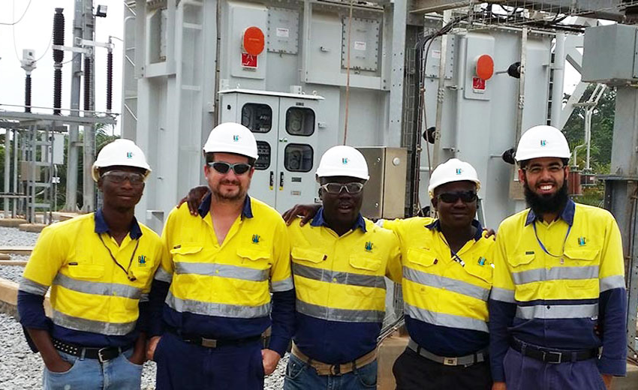
7. Organisational and Team
BEC operates a flat structure which allows for fast decision making and a high level of agility. In addition to the Engineering function, the company has dedicated Finance, Office and Human Resources teams.
Managing Director
Michael Drake-Brockman
Engineering Team
Office Team
Engineering team performs the BEC main engineering service lines of power systems, automation & controls, and E&I
Administrative team is responsible for the quality, company finance, office management and human resourcing functions.
Power Systems
James Leedman
Lead Drafter
Senior Drafter
Electrical Drafter
Document Control
Electrical & Instrumentation
Rick Di Filippo
Drafting Supervisor
Automation & Controls
Graham Cobb
Principal Engineers
Lead Engineers
Senior Engineers
Electrical Engineers
Graduate Engineers
Technology & Innovation
Michael Drake-Brockman
12

Slide 13

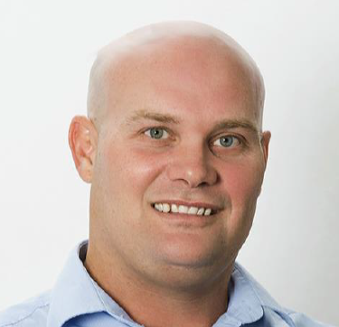
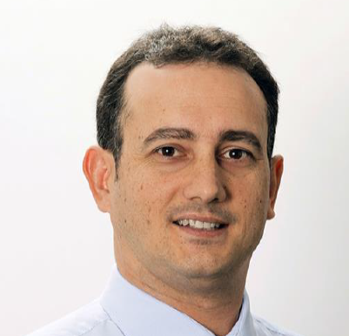

8. Leadership Team
Michael Drake-Brockman
Managing Director & Principal Consultant
B.Sc
Graham Cobb
Manager of Automation and Controls Director & Principal Engineer
B.Eng, MIEAust
Rick Di Filippo
Manager of Electrical & Instrumentation
Director & Principal Engineer
B.Eng, MIEAust
James Leedman
Manager of Power Systems
Principal Engineer
B.Eng, B.Sc, CPENG, MIEAust, RPEQ
Michael joined BEC in 2011 and has 32 years of experience in engineering and business management. Michael has been the Managing Director and Principal Consultant since 2018 and leads the BEC team across all areas of the business.
Michael has overseen the concept, design, and implementation of all of BEC's advanced mining solutions. These include the Partially Dumped Ore Car System, Gap Detection System, Volumetric Profiling System and Collision Avoidance System (see page 19).
Graham joined BEC in 1998 as an electrical engineer, being part of significant projects that span Australia, Africa, Asia and Papua New Guinea.
Graham’s experience is in mining and materials handling plants, process control, PLC and SCADA programming, control system networks, electrical and instrumentation design, and motor protection and control.
Graham has been involved in major projects including the Fortescue Anderson Point Port Operations, the Iluka Eneabba Mineral Sands plant, and the Lynas Kalgoorlie project in Western Australia, and provides electrical and controls support to multiple key mining clients across Australia.
Rick joined BEC in 1997 and has significant experience in the electrical design and consultancy services sector, working on significant projects that span East and West Africa, South America, South-East Asia, China, Western Australia and Queensland.
Rick’s expertise is in mining, processes, electrical, instrument and control, power systems, high voltage, protection and control, PLC programming and SCADA configuration. Major projects include the Black Swan Nickel Mine in Western Australia and the Tulawaka Gold Project in Tanzania.
James joined BEC in 2008 and has 18 years experience as an electrical power systems engineer specializing in electrical plants, mining installations, protection systems, earthing, system studies, instrumentation, and regulatory requirements with high voltage installations in Western Australia, Victoria and Queensland.
James has been involved in major projects such as the design of renewables substation for the Goldfields St Ives project in Western Australia and system study analysis for LNG generator connection and site power supply for LNG Limited in Queensland.

Slide 14
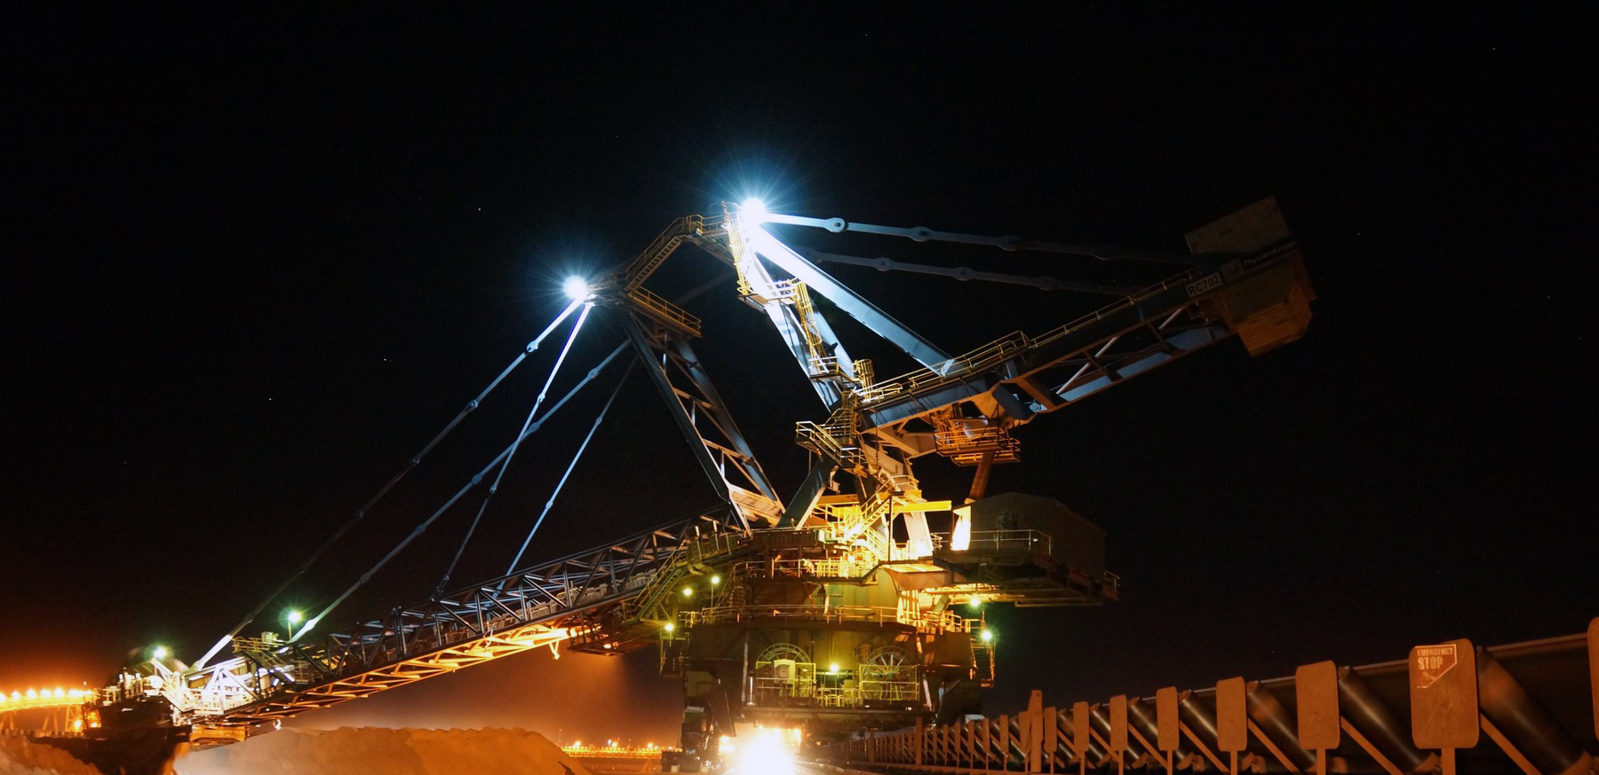
9. Recent Major Projects
BEC is primarily focused on servicing the WA mining industry with the map below illustrating a selection of recent projects.
Rio Tinto, Cape Lambert
Delivery of Rio Tinto laser scanning systems for ore car profiling and train unloader optimisation.
Fortescue, Port Hedland
Designed and commissioning of the Control System for the Iron Bridge, Canyon G magnetite expansion project.
Agnew Crushing Upgrade
Design of entire electrical design from the HV supply to the LV distribution and controls at Gold Fields’ Agnew operations.
Sunrise Dam, AngloGold Ashanti
Design of two 33/11 kV 15 MVA Mining Substations, a 33 kV Power Line and 11 kV Underground Feeder to supply new underground mining loads.
Iluka Resources Limited, Eneabba
E&I design, drafting and programming. Works included equipment specifications, workshop testing, site commissioning and support for the complete plant electrical and control system.
Lynas Kalgoorlie Cracking and Leaching Plant
HV, LV and Control System design and engineering works for the Rare Earths Processing facility in Kalgoorlie.
King of the Hills Gold Mine
Electrical and Control System design and development for the new gold processing hub.

